Slide 1
Explainable and Actionable Machine Learning Models for Electronic Health Record Data
Ming Lun Ong
Department of Electrical & Computer Engineering, National University of Singapore
Joint work with:
Mehul Motani, NUS/ECE
Anthony Li, Sengkang General Hospital, Singapore
Notes:
Elevator Pitch (working):
Thank you Jiaqing. Good morning, my name is Ming Lun from the Department of Electrical and Computer Engineering. Today, I will showcase my work on making black-box models understandable.
Recent advances in machine learning show immense promise for medical applications, but the black-box nature of these models make it difficult to deploy in practice. Extending from explainable machine learning methods, we develop a framework that enables actionability, allowing doctors to act on key features to mitigate disease risk. I will bring you through two methods which enable clinical explainability and actionability.

Slide 2
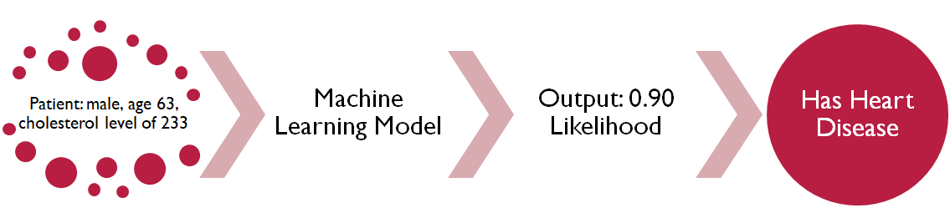
Machine Learning for Healthcare
General Machine Learning framework:
In recent years, deep learning models have seen massive breakthroughs. → Google's cancer diagnosis model outperformed doctors by an accuracy of 5%. → However, these state-of-the-art models are often complex black-boxes.
1. Input
2. Model
3. Output
4. Prediction
Source: End-to-end lung cancer screening with three-dimensional deep learning on low-dose chest computed tomography. https://www.nature.com/articles/s41591-019-0447-x
Notes:
Just as a recap, I would like to bring everyone through a high-level understanding of a typical machine learning framework.
Firstly, we take in a set of data.
https://interestingengineering.com/googles-medical-ai-detects-lung-cancer-with-94-accuracy

Slide 3
Why Explainable Machine Learning (ex-ML)?
Explainability helps shine light on the behaviour of machine learning models. This is essential for the following:
Demystify complex models Explanations deconstruct the behaviour of deep learning models.
Enable trust in the model Explanations foster trust amongst clinicians in machine learning.
Allow transparency Explanations expose latent biases that might creep into human-built models.

Slide 4
Explainable Machine Learning Methods
Inherent to model Some models (e.g., Logistic Regression) have an inherently interpretable structure.
SHAP (SHapley Additive exPlanations) Based on Shapley values, measures the change in the model output, when conditioned on a particular feature value.
LIME (Local Interpretable Model-Agnostic Explanations) Creates approximations around a given prediction instance, and fits a simpler interpretable model.
Outputs: Feature importance values, indicating the significance of each feature for a model’s prediction.

Slide 5
Explainability for Clinical Applications
While current explainability methods are useful, there are gaps to better-tailor these towards medical applications:
Narrow insight Current methods are limited, explaining a single instance, but do not generalise to multiple instances and possible values.
Not actionable Current methods identify important features, but do not identify what actions should be taken to change the outcome.
What we do: Our work takes the first steps to effectively address these gaps.
Notes:
Points that I want to make: - Current explanation methods only explain one static instance, but do not holistically explain an entire cohort.
- They do not address cases for which feature values change over time/the possible variance of feature values across the time-scale
- Additionally,
-

Slide 6
Using EHR data to predict cardiac disease
Data Information
Source: MIMIC-III Database Features: Demographic information (age, gender), lab test values (glucose, creatinine, white blood cell count, pO2, etc.) Details: 3960 instances (patients), 49 features
Machine Learning Problem
Problem: Identify if a patient would die in 5 years Data Engineering: Standaridised and missing data imputed with MICE Results: ML models are being trained: Logistic Regression (76.9%), Random Forest (77.3%), XGBoost (78.6%), MLP (76.7%)
Notes:
Timing checkpoint: 5 minutes
Use the numbers with the same format as previous slides
Talk a bit more about the features that we are using in the dataset
LEFT PANEL
Details about the data
RIGHT PANEL
Problem, data engineering, results

Slide 7
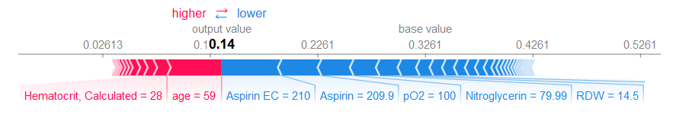
Explainability for one instance
We start with standard explainability methods. The current explanation methods only explain a single instance.
Current methods, such as SHAP and LIME, only explain a static set of feature values.
Notes:
Put this

Slide 8
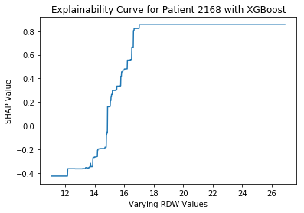
Clinical Explainability for an instance
Our method commences by expanding the explanation to all possible feature values.
This clinical explanation shows feature importances, over the entire range of possible feature values.
Notes:
pO2 – Partial Pressure of Oxygen in Blood (mmHg)
RDW is the Red Blood Cell Distribution Width, and this is measured in a percentage.
The graph shows how the effect of the RDW feature becomes significantly more positive as the RDW value increases. At lower RDW values, the feature value has a negative contribution to the outcome. At higher RDW values, above 15, we see that the feature values have a positive contribution to the prediction of heart disease.
We know that this correlates with medical knowledge, because an increased RDW value is correlated with heart disease.

Slide 9
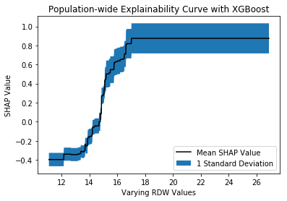
Clinical Explainability for a population
We obtain a distribution of which features are important across the whole population of patients.

Slide 10
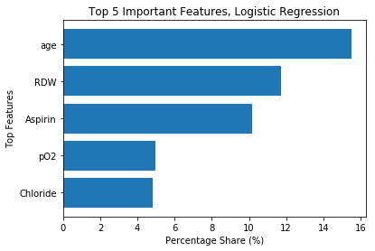
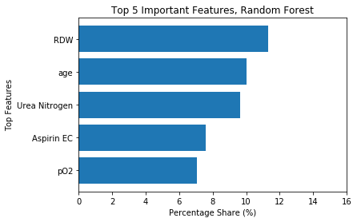
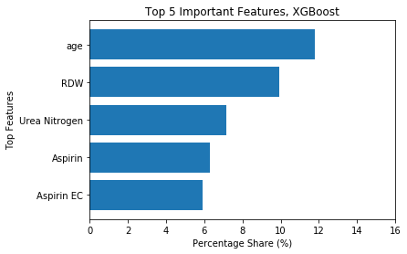
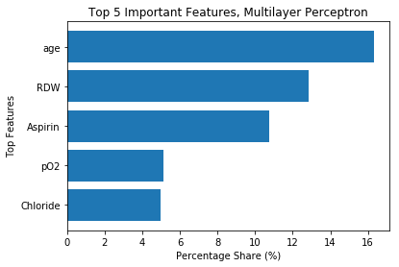
Feature Importance varies across models
Different ML models function in different ways: the features which are regarded as important differ.

Slide 11
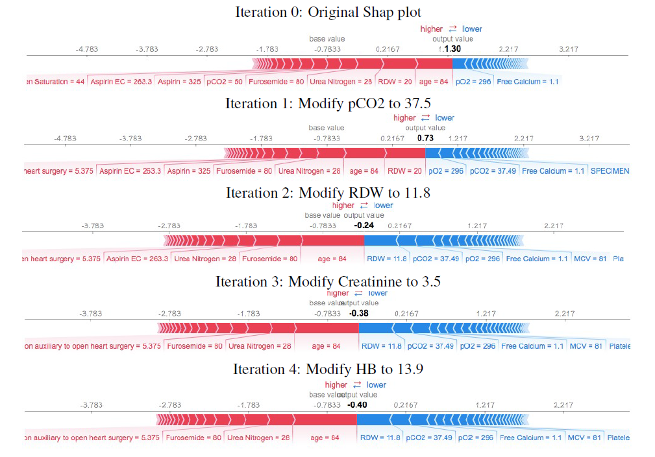
Actionability for one individual
We want to act on features to reduce a patient’s likelihood of disease.
Notes:
We see from the SHAP force plots that each set of original feature values is associated with a likelihood outcome from the model.
From the previous segment, we see that changing a particular value can reduce the impact on the outcome.
As such, we devise an action plan to reduce the likelihood of disease in a patient. There is an optimal point on the explainability curve

Slide 12
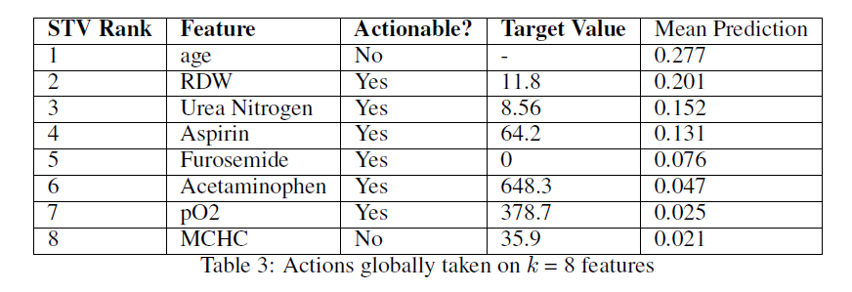
Actionability across an entire population
Across an entire population, we want the incidence of disease to be reduced. As such, we address the features that, when acted upon, reduce disease prevalence in a population.

Slide 13
Conclusions
Overview
Explainability methods are a promising solution to the black-box problem.
However, more work needs to be done to expand explanations, and address the lack of actionable insight.
Where does the field of explainability need to go?
Moving from explainability, we want ML models to be actionable, so that they can motivate and recommend action.
To strengthen the case for actionability, further work is needed to establish causality in machine learning.
Notes:
Make it very clear that these are first steps in pointing the gaps (narrow insights/lack of actionability)
I hope I have shown you a way to bridge to these gaps.
Future work
We want to strengthen the actionability component: the lack of actionability is critical.

